Slide 1

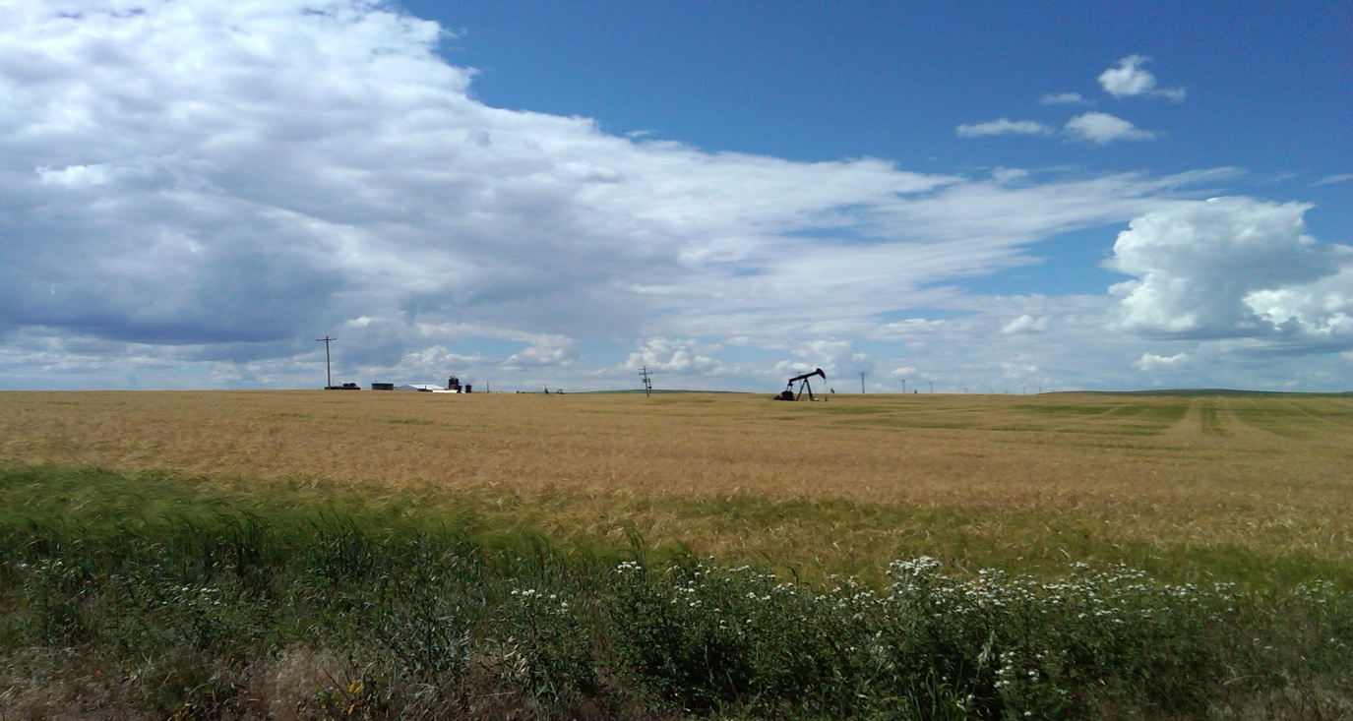
TSX-V: MVW
Emerging Light Oil Focused Junior South of the Border
November 2011
Notes:
New logo should be done soon!

Slide 2
Reader Advisory
Forward Looking Statements
In the interest of providing potential investors with information regarding Mountainview Energy Ltd. ("Mountainview"), including management's assessment of the future plans and operations of Mountainview, certain statements contained in this corporate presentation constitute forward-looking statements or information (collectively "forward-looking statements") within the meaning of applicable securities legislation. Forward-looking statements are typically identified by words such as "anticipate", "continue", "estimate", "expect", "forecast", "may", "will", "project", "could", "plan", "intend", "should", "believe", "outlook", "potential", "target" and similar words suggesting future events or future performance. In addition, statements relating to "reserves" are deemed to be forward-looking statements as they involve the implied assessment, based on certain estimates and assumptions, that the reserves described exist in the quantities predicted or estimated and can be profitably produced in the future. Forward looking statements or information in this presentation include, but are not limited to, statements or information with respect to: the expected closing date and use of proceeds from the financing; potential reserves and future production with respect to current assets business strategy and objectives; development plans; exploration and drilling plans; reserve quantities and the discounted present value of future net cash flows from such reserves; future production levels; wells drilled (gross and net); capital expenditures; cash flow; debt levels; operating and other costs; royalty rates and taxes.
With respect to forward-looking statements contained in this corporate presentation, Mountainview has made assumptions regarding, among other things: future capital expenditure levels; future oil and natural gas prices; future oil and natural gas production levels; future exchange rates and interest rates; ability to obtain equipment in a timely manner to carry out development activities; ability to market oil and natural gas successfully to current and new customers; the impact of increasing competition; the ability to obtain financing on acceptable terms; and ability to add production and reserves through development and exploitation activities. Although Mountainview believes that the expectations reflected in the forward looking statements contained in this corporate presentation, and the assumptions on which such forward-looking statements are made, are reasonable, there can be no assurance that such expectations will prove to be correct. Readers are cautioned not to place undue reliance on forward-looking statements included in this corporate presentation, as there can be no assurance that the plans, intentions or expectations upon which the forward-looking statements are based will occur. By their nature, forward-looking statements involve numerous assumptions, known and unknown risks and uncertainties that contribute to the possibility that the predictions, forecasts, projections and other forward-looking statements will not occur, which may cause Mountainview's actual performance and financial results in future periods to differ materially from any estimates or projections of future performance or results expressed or implied by such forward-looking statements. These risks and uncertainties include, among other things, the ability of management to execute its business plan; general economic and business conditions; the risk of instability affecting the jurisdictions in which Mountainview operates; the risks of the oil and natural gas industry, such as operational risks in exploring for, developing and producing crude oil and natural gas and market demand; the possibility that government policies or laws may change or governmental approvals may be delayed or withheld; risks and uncertainties involving geology of oil and natural gas deposits; the uncertainty of reserves estimates and reserves life; the ability of Mountainview to add production and reserves through acquisition, development and exploration activities; Mountainview's ability to enter into or renew leases; potential delays or changes in plans with respect to exploration or development projects or capital expenditures; the uncertainty of estimates and projections relating to production (including decline rates), costs and expenses; fluctuations in oil and natural gas prices, foreign currency exchange rates and interest rates; risks inherent in Mountainview's marketing operations, including credit risk; uncertainty in amounts and timing of royalty payments; health, safety and environmental risks; risks associated with existing and potential future law suits and regulatory actions against Mountainview; uncertainties as to the availability and cost of financing; and financial risks affecting the value of Mountainview’s investments. Readers are cautioned that the foregoing list is not exhaustive of all possible risks and uncertainties.
Any financial outlook or future oriented financial information in this corporate presentation, as defined by applicable securities legislation, has been approved by management of Mountainview. Such financial outlook or future oriented financial information is provided for the purpose of providing information about management's current expectations and plans relating to the future. Readers are cautioned that reliance on such information may not be appropriate for other purposes.
The forward-looking statements contained in this corporate presentation speak only as of the date of this corporate presentation. Except as expressly required by applicable securities laws, Mountainview does not undertake any obligation to publicly update or revise any forward looking statements, whether as a result of new information, future events or otherwise. The forward-looking statements contained in this corporate presentation are expressly qualified by this cautionary statement. The information contained in this corporate presentation does not purport to be all-inclusive or to contain all information that a prospective investor may require. Prospective investors are encouraged to conduct their own analysis and reviews of Mountainview, and of the information contained in this corporate presentation. Without limitation, prospective investors should consider the advice of their financial, legal, accounting, tax and other advisors and such other factors they consider appropriate in investigating and analyzing Mountainview.
Barrels of Oil Equivalent
Barrels of oil equivalent (boe) is calculated using the conversion factor of 6 Mcf (thousand cubic feet) of natural gas being equivalent to one barrel of oil. Boes may be misleading, particularly if used in isolation. A boe conversion ratio of 6 Mcf:1 bbl (barrel) is based on an energy equivalency conversion method primarily applicable at the burner tip and does not represent a value equivalency at the wellhead.
Analogous Information
Certain information in this document may constitute "analogous information" as defined in National Instrument 51-101 – Standards of Disclosure for Oil and Gas Activities ("NI 51-101"), including, but not limited to, the reservoir data and economics information relating to the areas in geographical proximity to prospective exploratory lands to be held by Mountainview. Such information has been obtained from government sources, regulatory agencies or other industry participants. Management of Mountainview believes the information is relevant as it helps to define the reservoir characteristics in which Mountainview may hold an interest. Such information includes resource estimates using categories such as Original Oil-In-Place which are not derived from the Canadian Oil and Gas Evaluation Handbook ("COGE Handbook") and have therefore not been prepared in accordance with NI 51-101. Mountainview is also unable to confirm that the analogous information was prepared by a qualified reserves evaluator or auditor. Such information is not an estimate of the resources attributable to lands held or to be held by Mountainview and there is no certainty that the reservoir data and economics information for the lands held or to be held by Mountainview will be similar to the information presented herein. The reader is cautioned that the data relied upon by Mountainview may be in error and/or may not be analogous to such lands to be held by Mountainview.

Slide 3
Business Overview
Mountainview is a light oil focused junior entity focused immediately South of the Canadian border in Montana and North Dakota
Holds over 25,000 net acres in the Williston Basin and 80,000 net acres Alberta Bakken and is targeting Bakken/Three Forks plays
Management is based in and has had a strong focus in Montana/North Dakota with access to services, infrastructure and continued land deals
Recent acquisition of a further 13,400 net acres in the Williston Basin and a large U.S. independent company, will operate the Medicine Lake Project
Targeting a capital program of $17.2 million in 2012 with 12 horizontal gross wells and one vertical in the Williston Basin

Slide 4
Corporate Overview
Share Listing: | TSX-V “MVW.V”
Basic Shares Outstanding: | 106.9 million
F.D. Shares Outstanding | 111.3 million
Insider Ownership: | ~ 66%
Debt: | $1.1 Million Convertible Debenture @ $2.50
Working Capital: | Approx. $1.5 million
Current Production: | 175 boe/d (85% Oil & Liquids)
Land: | 105,000 net acres of Bakken / Three Forks in the Williston Basin and Alberta Bakken

Slide 5
Management
Management
Executive | Position | Most Recent Position(s)
Patrick Montalban | President & Chief Executive Officer | President & CEO – Altamont Oil & Gas Executive VP & COO – Quicksilver Resources
Angelique Hatch | Chief Financial Officer | Corporate Controller- Andean American Gold Corp.
Joseph P. Montalban | Chief Operating Officer | Field Supervisor – Mountainview Energy
Carla Barringer | Secretary & Treasurer | Secretary & Treasurer – Altamont Oil & Gas
Pete Losing | Field Superintendent | Field Superintendent – Quicksilver Resources
Advisors
Department | Consultants / Geologists | Expertise / Experience
Land/Geology: | Carter Stewart – Exploration Geologist Don Thompson – Wellsite Geologist Bobby J. Purcell – Consultant John A. “Chip” Miller – Consultant | Geologist in Williston Basin for 20 + years Horizontal Drilling in Williston Basin Professional Land Woman Professional Land Man
Engineering: | Ted Webb – Independent Engineer Citadel Engineering Ltd. MBI Oil and Gas- Jeff Kummer | Reservoir Engineer Reservoir Engineer Horizontal Drilling/Completion Engineer

Slide 6
Board of Directors
Directors
Board Member | Position | Most Recent Position(s)
Patrick Montalban | CEO & Chairman of Board | President & CEO – Altamont Oil & Gas Executive VP & COO – Quicksilver Resources
Keith MacDonald | Independent Director | Director – Surge Energy Inc., Bellatrix Exploration
Denny Hop | Independent Director | Former Director – Breaker Energy
Bo Mikkelsen | Independent Director | President – Emissions Plus
Carla Barringer | Corporate Secretary | Secretary & Treasurer – Altamont Oil & Gas

Slide 7
Asset Overview
ALBERTA
SASKATCHEWAN
Mountainview Current Production:
175 boe/d (85% Oil & Liquids)
Land: 105,000 net acres
Stateline Prospect
Bakken, Three Forks, and Red River Oil Potential
12,000 net acres (100% W.I.)
Operator
Medicine Lake Prospect
Bakken, Three Forks, and Red River Oil Potential
13,400 net acres (20% W.I.)
Non Operator
Alberta Bakken
Williams Gas Field & Lake Frances Gas Field/Alberta Bakken Prospect
500 mcf/d, 70,000 net acres
Operator
Red Creek Field
120-150 boe/d
2,500 net acres
Operator
Lone Man Coulee
10-20 boe/d
SW Pondera Project
10-20 boe/d
Snoose Coulee Gas Field
100 mcf/d
Williston Basin
NORTH DAKOTA
MONTANA

Slide 8
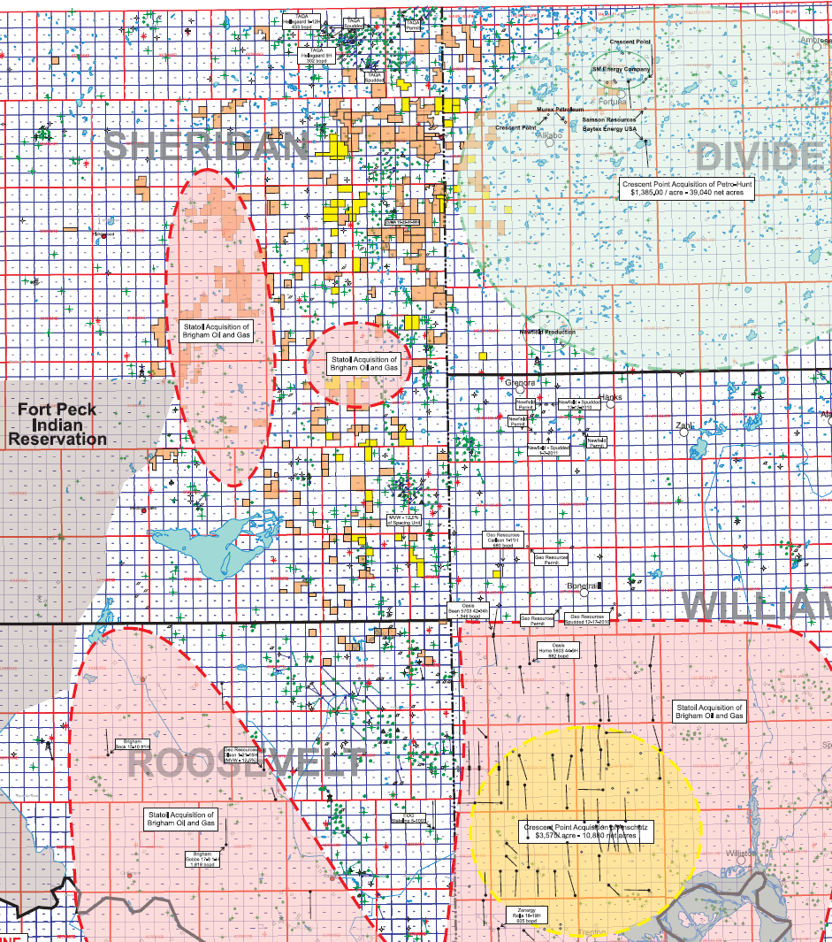
Stateline Prospect / Medicine Lake Prospect
TAQA Oil Wells
25,400 total net acres –approx. $1,150 per acre
12,000 acres (100% WI, 78% NRI)
67,000 gross acres/13,400 net acres
20 % WI, 80% NRI
2011/2012 capital program: $17 million
1 Vertical, 12 gross Horizontals
Several large nearby producers
TAQA, Baytex, Crescent Point, EOG, Brigham, Geo Resources
Well production range: 200 – 1,000 boe/d in first month
Stacked pay zones: Ratcliffe, Mission Canyon, Nisku, Gunton, Bakken, Three Forks, and Red River
Continuing to build our acreage position using our strong Williston Basin relationships
Crescent Point, Samson, Baytex, and SM Energy Bakken well spuds
Oasis and Geo Resources Oil Wells
Stateline/Medicine Lake Prospects
Stateline- Yellow
Medicine Lake- Orange
Statoil-Brigham acreage Acquisition – Dotted Red
Crescent Point acreage Acquisition – Dotted Green & Yellow

Slide 9
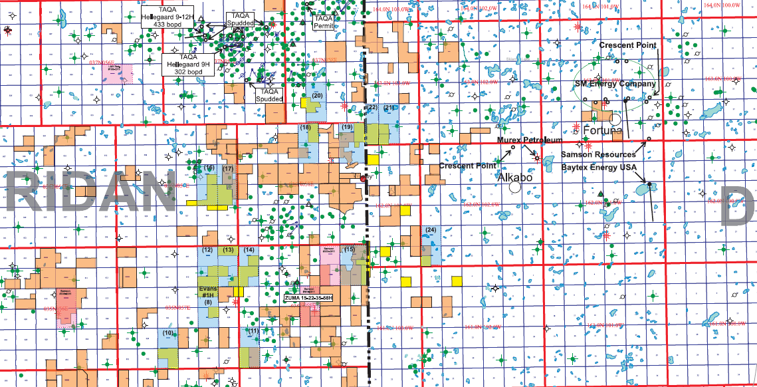
Drilling Activity in Interest Areas
Nearby Bakken Well Results:
TAQA North USA, INC- Hellegaard #9-12H - IP- 433 bopd, 150 mcf/d, 236 bbl/d Samson Resources – Zuma 15-22-35-58H, 1280 acre spacing
Short Leg-640 Sheridan County, MT – MVW will have non-op working interest
Sheridan County, MT *Has produced over 110,000 Barrels in 13 months*
TAQA North USA, INC- Hellegaard 9H - IP- 235 bopd, 85 mcf/d, 434 bbl/d, Short Leg- 640 SM Energy – Wolter 13-23H
Sheridan County, MT Divide County, MT - MVW will have approx. 1.8% working interest
TAQA North USA, INC – Hellegaard 9-13H – IP- 333 boe/d
Sheridan County, MT *Has produced over 53,000 barrels in 8 months*
◆

❖

⬥
◆
⬥

❖

Northern Stateline/Medicine Lake Project
Stateline- Yellow
Medicine Lake- Orange
MVW Spacing Unit- Blue
Competitor Spacing Unit- Pink

Slide 10
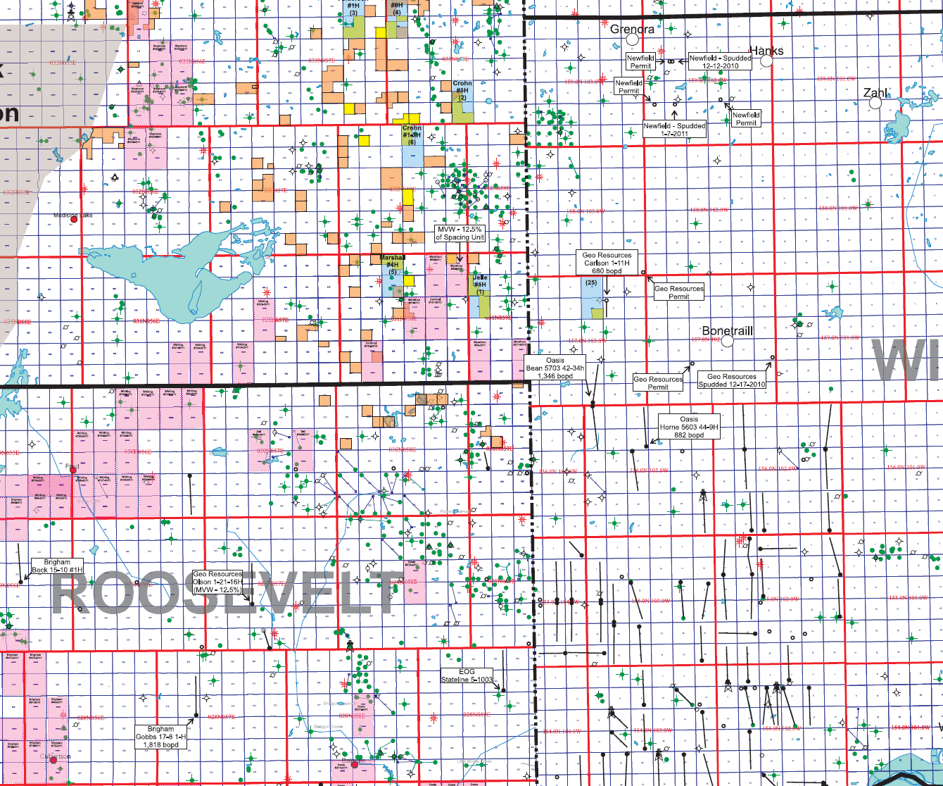
Drilling Activity in Interest Areas continued
◆
Brigham Exploration – Gobbs 17-8 1H – IP – 1,808 BOPD
Roosevelt County, MT
1280 acre spacing
❖
GeoResources, Inc- Carlson 1-11H - IP- 685 boe/d
Williams County, ND
Short Leg-640
Stephens Energy LLC Spacing units
❖
⬥
Oasis – Bean 5703 42-34h – IP – 1346 BOPD
Williams County, ND
1280 acre spacing
⬥

GeoResources, Inc – Olson 1-21-16H – waiting on IP
Roosevelt County, MT
1280 acre spacing
MVW-12.5% Working Interest
Marathon, Brigham, and Whiting Spacing units

◆
Northern Stateline/Medicine Lake Project
Stateline- Yellow
Medicine Lake- Orange
MVW Spacing Unit- Blue
Competitor Spacing Unit- Pink

Slide 11
Mountainviews Non-Operated Bakken Wells
Non-Operated Bakken Well list
Operator | Well Name/Location | 24 hour IP | MVW’s Working Interest
G3 Operating | Olson 1-21-16H | TBD | 12.5%
Samson Resources | Zuma 15-22-35-58H | Waiting to spud | TBD
SM Energy | Wolter 13-23H | Confidential List | 1.8%
Marathon Oil Corp | T31N-R58E Sec. 1 & 12 | Spud date TBD | TBD
Marathon Oil Corp | T31N-R58E Sec. 3 & 10 | Spud date TBD | TBD

Slide 12
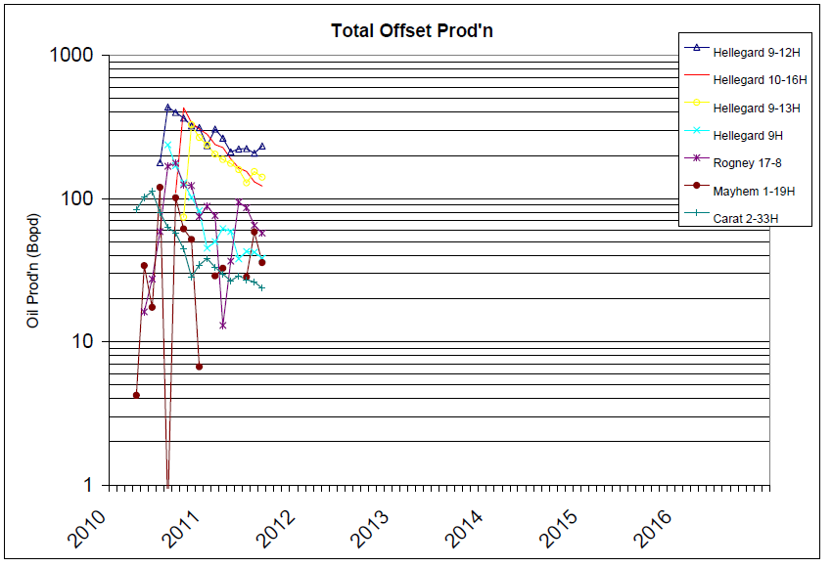
Mountainview Forecast Well vs. Offset Production

Slide 13
Red Creek Field
2,500 gross/net acres, operator
Evaluating AB Bakken potential
Current Production: 120 – 150 boe/d
35 producing wells (Madison, Lower Cut Bank Sandstone, Upper Cut Bank Sandstone)
3 Injection-Disposal wells
3D seismic
2011 capital program: $0.5 million
$500,000 – 2 vertical Madison wells
Snoose Coulee Gas Field
100 mcf/d
Red Creek Field
120-150 boe/d
Williams Gas Field & Lake Frances Gas Field
500 mcf/d
Lone Man Coulee
10-20 boe/d
SW Pondera Project
10-20 boe/d

Slide 14
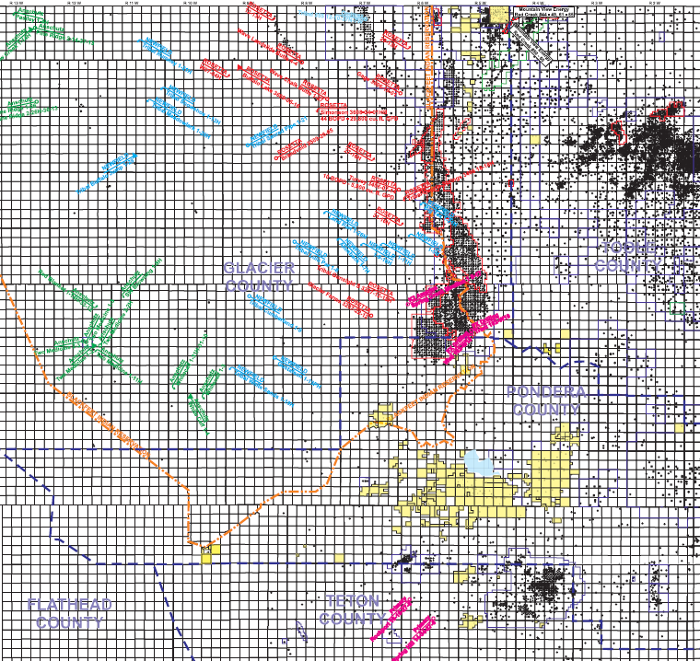
Drilling Activity in Interest Areas (continued)
Rosetta Resources, Newfield Exploration, and Anschutz Exploration have recently been drilling Bakken wells in the area
According to Rosetta they believe there is between 13 - 15 MMboe per square mile of resource in place. ⁽¹⁾
Newfield Exploration has released a well that had an IP of 225 bbls/day. They also stated that only 30% of the well was completed successfully.
Montana Board of Oil and Gas has recorded at least 45 wells that have been permitted, spudded, or drilled by these three companies. ⁽²⁾
Prospective formations: Mission Canyon, Lodgepole, Bakken, and Three Forks
Approx. $500 million has been spent to date on land, Joint Venture deals, and drilling
Anschutz Exploration: 9 spudded, 4 permits
Rosetta Resources: 13 spudded, 4 permits
Newfield Exploration: 7 spudded, 8 permits
(1) http://ir.rosettaresources.com/presentations.cfm
(2) Montana Board of Oil and Gas Commission website

Slide 15
Williston Basin Bakken/Three Forks Well Data
Well Economics
Economics | TAQA-Hellegaard 9-12H Bakken Reservoir | Mountainview Forecast Well
Initial Oil Prod. Rate | 433 bbl/d | 600 bbl/d
Initial Gas Prod. Rate | 150 mcf/d | 200 mcf/d
Capital | $4,400,000 | $6,624,000
Future Net Profit, Discounted at 10% | $4,657,155 | $21,410,768
Rate of Return | 100% / year | 100% / year
Return on Investment | 2.40 | 3.23
Spacing Unit | 640 | 1280
Frac job | 18 stages | 30 stages
Operating Netbacks
Economics | TAQA-Hellegaard 9-12H Bakken Reservoir | Mountainview Forecast Well
Revenue ($/boe) | $70.00 | $78.00
Royalty Rate (%) | 13.75% | 20-22%
Operating Costs ($/boe) | $12,000 a month | $9,700 a month
Operating Netback ($/boe) | $59.45 bopd | $60.30 bopd
Sources: Rocky Mountain Oil & Gas Journal, Montana Board of Oil & Gas (http://bogc.dnrc.mt.gov)

Slide 16
Mountainview Forecast
2011 Year End
Production - 201 boe/d
Cash Flow - $0.7 million
Total capital Requirement - $2.0 million
2012 Year End
Production – 1,358 boe/d
Cash Flow - $12.3 million
Total Capital Requirement - $17.2 million

Slide 17
For current lease holdings:
2012 Capital Program
Capital Program
Drilling: | 4-5 gross Verticals, 12 gross Horizontals
Medicine Lake Project: | $4,200,000
Stateline Project: | $9,900,000 (6 Horizontals)
Lake Frances AB Bakken: | $400,000 (2 Vertical Bow Island Wells)
Red Creek: | $500,000 (2 Vertical Madison Sun River Dolomite Wells)
Williston Basin Land Acquisitions: | $2,000,000
Maintenance Capital: | $200,000
Total Capital Required: | $17,200,000
Mountainview Energy will participate in a total of 6 gross Bakken wells in 2012 on its Medicine Lake Project
Larger Independent will Operate these wells
Well Cost ~$7,000,000
MVW estimated average cost = $700,000 ~ 10% average Working Interest
Mountainview plans to drill and operate 6 gross Bakken wells on its Stateline Project
Well Cost = $6,600,000
MVW estimated average cost = $1,650,000 ~ 25% average Working Interest
Mountainview has budgeted for land acquistions to increase its ownership in operated spacing units and also to pursue non-operated positions
Mountainview plans to do developmental drilling on its conventional plays to keep production steady.

Slide 18
Implied Valuation
Net Asset Value
Implied Valuation Applying Varying Acreage Values for North Dakota Bakken Land ⁽¹⁾
 | $1,500/acre (North Dakota Bakken) | $2,500/acre (North Dakota Bakken) | $3,500/acre (North Dakota Bakken)
North Dakota Bakken – 25,400 Net Acres⁽¹⁾: | $38,100,000 | $63,500,000 | $88,900,000
AB Bakken – 80,000 Net Acres at $500/acre⁽²⁾: | $40,000,000 | $40,000,000 | $40,000,000
Total Estimated Value of Net Undeveloped Acres: | $78,100,000 | $103,500,000 | $128,900,000
Production @ $60,000/boed (175 boed) | $10,500,000 | $10,500,000 | $10,500,000
Net Debt (including dilutive proceeds) | $5,552,000 | $5,552,000 | $5,552,000
Total Estimated Net Asset Value | $83,048,000 | $108,448,000 | $133,848,000
FD Shares outstanding | 111,246,805 | 111,246,805 | 111,246,805
Value per Share | $0.75 | $0.97 | $1.20
Valuing North Dakota Bakken acreage of 25,400 Net Acres at $1,500/acre, $2,500/acre, and $3,500/acre as a comparison to the average land acquisition cost paid in the Crescent Point/Anschutz transaction of $2,500/acre (net of value for production)
As per Primary Petroleum’s farm in deal
18

Slide 19
Reasons to Invest In Mountainview
Strong acreage position in the Williston Basin targeting the Bakken and Three Forks play
Stateline Project ~ 12,000 net operated acres
25 gross exploratory locations, if proven successful Mountainview will have an additional 75 gross locations
Medicine Lake Project ~ 20% of 67,000 net non-operated acres (13,400 net to Mountainview)
Large independent company will operate
125 gross exploratory locations
MVW plans to participate in 7 gross horizontal wells in 2011/2012
Strong acreage position in the South Alberta Bakken Play
MVW controls approx. 80,000 net acres
Increased land and drilling activity in the areas
Large producers have nearby land positions – Newfield Exploration, Rosetta Resources and Anschutz Exploration
Management’s history of operating in the Rocky Mountain Regions
Management has drilled/operated over 350 wells in Montana, North Dakota, Texas, Alberta, Utah, New Mexico
Management’s strong Williston Basin relationships gives Mountainview access to numerous oilfield services and the ability to acquire more Bakken/Three Forks acreage
Missouri Basin Well Service/MBI Oil and Gas
Carter Stewart – 20+ years of Williston Basin Geological experience

Slide 20
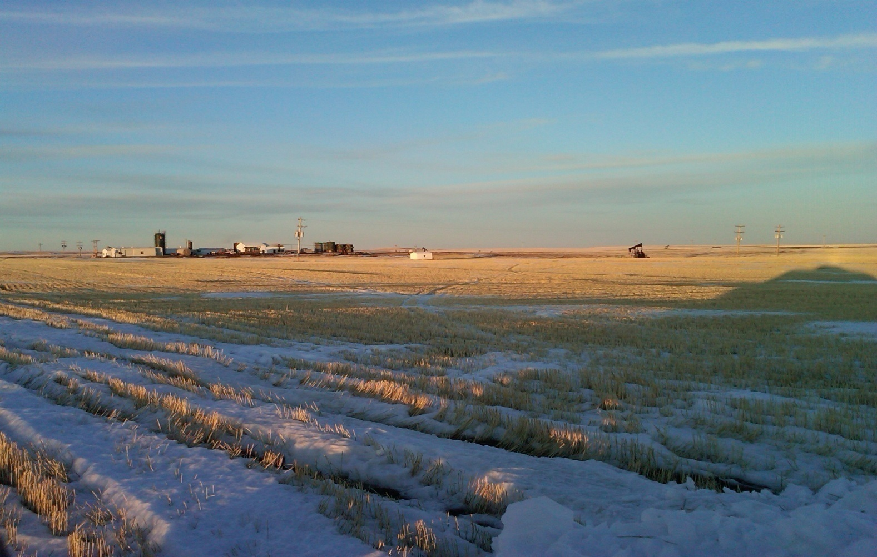
Appendix

Slide 21
Advisors
Advisors
Accounting/Audit: | PricewaterhouseCoopers, LLP – Independent Auditor
Corporate Counsel: | Stella Business Law – Stephen Tong Burnet, Duckworth, & Palmer – Jay Reid
Oil and Gas Attorney: | Dick Beatty Loren O’Toole

Slide 22
Fully Diluted Shares Outstanding
Initial Shares: | 9,766,850
Private Placement at $0.225 Warrants from Private Placement at $0.32 Finders Fee Warrants at $0.32 Finders Fees 1st PP Carter Stewart & Jim Arthaud Acquisition Private Placement at $0.90 | 21,000,000 5,250,000 738,253 876,660 18,611,111 2,777,777
Current Shares Outstanding | 59,020,651
Altamont Oil & Gas, Inc. Acquisition Numbers et al Acquisition | 7,822,727 5,027,273
Medicine Lake Acquisition | 35,046,154
Post Acquisitions Shares Outstanding | 106,916,805
Stock Options | 4,330,000
Fully Diluted Shares Outstanding | 111,246,805

Slide 23
North Dakota Bakken/Three Forks Well Data
Reservoir Data: | TAQA-Hellegaard 9-12H Bakken Reservoir | Mountainview Forecast Well
Reservoir Rock Properties / Producing Zone: | Bakken Mississippian/Devonian 7300 – 7800’ Fractured Silty Dolomite Shale | Bakken Mississippian/Devonian 7500 – 8700’ Fractured Silty Dolomite Shale
Reservoir Data and Volumetrics:
Area of Spacing Unit: | 640 Acres | 1,280 Acres
Reservoir Pressure: | 3000 psi | 3300 psi
Reservoir Temperature: | 180°F | 185*F
Reservoir Drive Mechanism: | Solution Gas / Expansion | Solution Gas/ Expansion
Oil Gravity: | 42°API | 42* API
Gas/Oil Ratio: | N/A | 450 SCF per STB
Gas Properties: | N/A | .6 Specific Gravity
Average Porosity: | 11% | 9%
Thickness: | 18 Feet | 40-50 feet
Average Water Saturation | 50% | 35%
Formation Volume Factor (BO): | 1.29 Res bbl/STB | 1.14 Res bbl/STB
Original Oil in Place: | 3,812,066 STB | 23,040,000 STB
Recovery Factor: | 5% of OOIP | 3% of OOIP
Volumetric Reserves: | 190,603 STB | 768,000 MSTB
Basic Well Data:
Total Depth: | 11,838 Feet | 8,700 Feet
Initial Production: | 430 BOPD, 150 MCFD, 236 BWPD | 600 BOPD, 200 MCFD, 210 BWPD
Sources: Rocky Mountain Oil & Gas Journal, Montana Board of Oil & Gas (http://bogc.dnrc.mt.gov)

Slide 24
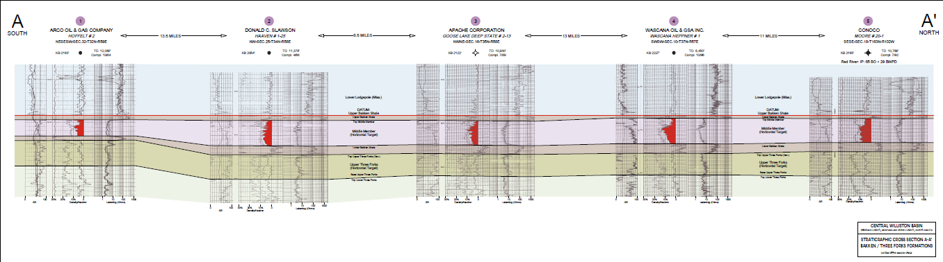
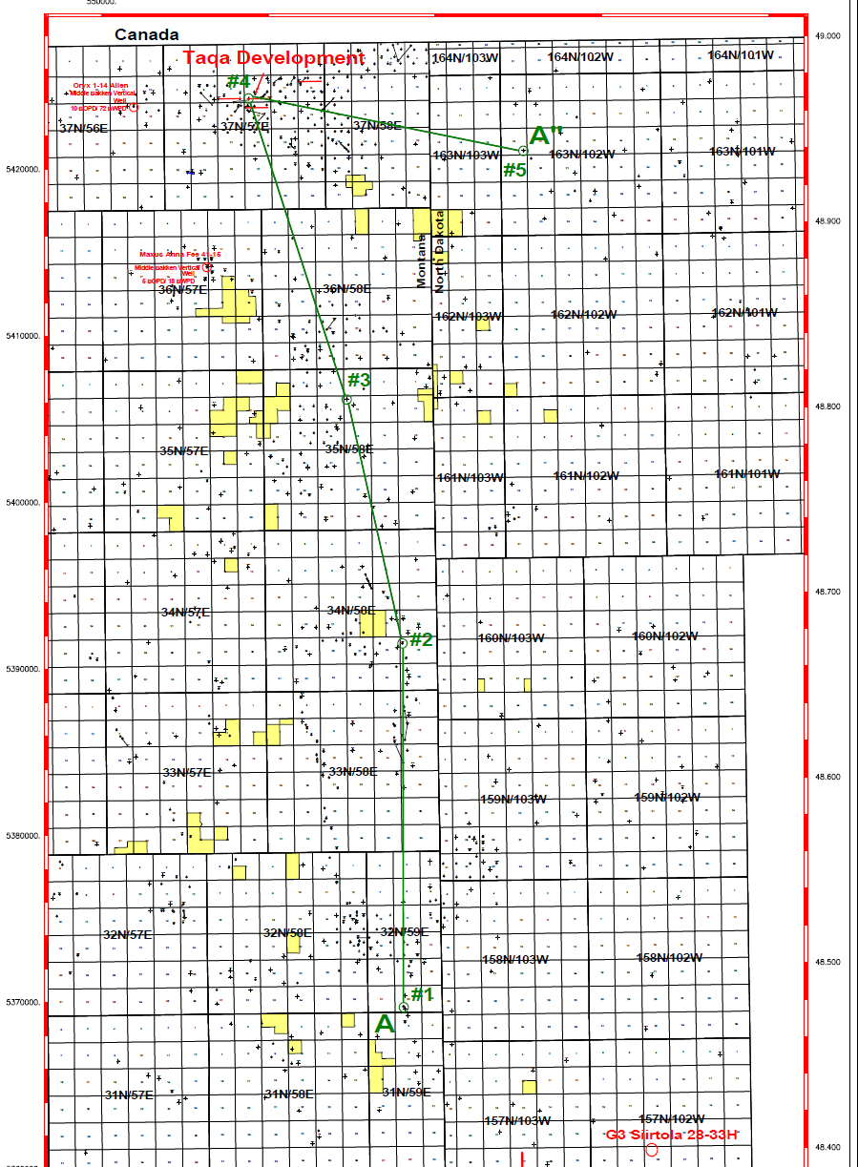
Mountainview’s Stateline Cross Section
Middle Bakken Silt actually thickens to the North
Wells used in Cross Section are relatively close the Mountainview Acreage
Cross section shows that Mountainview acreage is also prospective for Three Forks

Slide 25
Mountainview Stateline Locations
Location 1: Sec. 7 & 18 T31N-R59E Gross: 640.00 Unit Ownership Gross: 23% MVW Costs: $1,610,000 Net: 300.00 Net: 18%
Location 2: Sec. 27 & 34 T33N-R58E Gross: 646.83 Unit Ownership Gross: 13% MVW Costs: $ 910,000
Net: 165.00 Net: 10%
Location 3: Sec. 2 & 11 T33N-R57E Gross: 480.00 Unit Ownership Gross: 28% MVW Costs: $1,960,000
Net: 360.00 Net: 22%
Location 4: Sec. 6 & 7 T33N-R58E Gross: 320.00 Unit Ownership Gross: 23% MVW Costs: $1,610,000
Net: 300.00 Net: 18%
Location 5: Sec. 4 & 9 T31N-R58E Gross: 400.04 Unit Ownership Gross: 16% MVW Costs: $1,120,000
Net: 200.00 Net: 12%
Location 6: Sec. 3 & 10 T32N-R58E Gross: 318.32 Unit Ownership Gross: 25% MVW Costs: $1,750,000
Net: 318.32 Net: 19.5%
Location 7: Sec. 15 & 22 T34N-R58E Gross: 320.00 Unit Ownership Gross: 24% MVW Costs: $1,680,000
Net: 310.44 Net: 19%
Location 8: Sec. 14 & 23 T35N-R57E Gross: 480.00 Unit Ownership Gross: 38% MVW Costs: $2,660,000
Net: 480.00 Net: 30%
Location 9: Sec. 14 & 23 T34N-R58E Gross: 320.00 Unit Ownership Gross: 24% MVW Costs: $1,680,000
Net: 310.44 Net: 19%
Location 10: Sec.28 &33 T35N-R57E Gross: 480.00 Unit Ownership Gross: 38% MVW Cost: $2,660,000
Net: 480.00 Net: 30%
Total: $17,640,000

Slide 26
Management / Director Bios
Patrick M. Montalban: Mr. Montalban has been active in the oil and gas exploration and production industry for over thirty (30) years. Mr. Montalban started his career in the Industry as a roughneck beginning in the Summer of 1977. He graduated from the University of Montana in 1981 with a B.A. in Geology. Mr. Montalban became Vice President of Exploration and Production during the mid 1980’s for MSR Exploration Ltd (MSR), an Alberta Public Oil & Gas Exploration Company with Corporate Offices in Cut Bank, Montana. MSR was listed for trading on American Stock Exchange (until 1997 when the Company merged with Mercury Exploration, a subsidiary of Quicksilver Resources, Inc). Patrick furthered his career with MSR becoming President and Chief Executive Officer of its U.S. Subsidiaries (Mountain States Resources, Inc., Monte Grande Exploration, Inc., Gypsy Highview Gathering System, Inc., and MSR Exploration, Inc in 1991, while later becoming Executive Vice President of Exploration, Acquisitions, Production and Chief Operating Officer, as well as Director in 1996. Mr. Montalban formed his first oil and gas exploration and production company in 1999, known as Altamont Oil & Gas, Inc. Altamont is a private Company 100% owned by Montalban, who is also the President & CEO. He also formed and is President & CEO of Genesis Energy, Inc., a private gas gathering and compression Company. Patrick M. Montalban is currently President & CEO and Director of Montaban Oil & Gas Operations, Inc., (MOGO, INC) a private Company formed by his Father, Mr. Joseph V. Montalban. Mr. Montalban is also currently President & CEO and Director of Mountainview Energy Ltd.
Bo L. Mikkelsen: Mr. Mikkelsen holds a Masters Degree in Mechanical Engineering from the University of Manitoba. He is the founder and President of Engine Technology Support, Inc. since 1993, which company applies patented emission control technology to industrial fueled lean burn engines. He has also been President of Emissions Plus, Inc. since 1988, which company was founded to apply the PSC system of emission control to industrial gas fueled rich burn engines.
Keith MacDonald: Mr. Macdonald is President of Bamako Investment Management Ltd. a private investment and financial consulting company. He brings over 30 years of experience in the financing and growing of oil and gas businesses in Canada, the United States and internationally to the Company’s team. Mr. Macdonald is currently and previously a director and/or founder of a number of publically traded and private companies in the oil and gas, mining and agriculture/construction equipment industries. He has a well rounded Board experience relating to corporate and business strategy, corporate governance and regulatory compliance, compensation issues, auditing and financial controls and oil and gas reserves. He is a Past Chairman and Director of the Small Explorers and Producers of Canada. Mr. Macdonald was founder and President of New Cache Petroleums Ltd. in 1987 and grew the company to 5,000 boepd prior to its sale in early 1999. He is a Chartered Accountant and currently a member of the Canadian and Alberta Institutes of Chartered Accountants.
Denny Hop: Mr. Hop was one of the founders of Breaker Energy in late 2005 and was on the Board of Directors since inception until Breaker was sold in late 2010 for $300 Million to NAL Oil and Gas. Breaker was a start-up junior and at the time of sale was at a production level of over 7200 boepd. Mr. Hop chaired the Compensation Committee at Breaker. Mr. Hop currently sits on the Board of Pacific Northwest Capital, a TSX listed mining company. Mr. Hop is the Principal and Founder of Hop Estate Planning Partners in Calgary, which specializes in estate planning and wealth transfer strategies for private business owners and affluent families, and has been in this area of specialty since 1982. Mr. Hop is also a fifty percent partner in Uniglobe Travel (Western Canada) Inc., with 38 locations in Western Canada and has been involved in this business since 1989. Mr. Hop has a Masters Degree in Administration from the University of Calgary and is involved with several organizations including the World Presidents Organization (WPO) Alberta Chapter, the Society of Tax and Estate Planning (STEP) Alberta Chapter, the Alberta Family Business Organization, the Calgary Society of Estate Planners, and Conference for Advanced Life Underwriters (CALU) of Canada.
Carla Barringer: Ms. Barringer has worked in the Oil and Gas Industry since 1991, beginning with MSR Exploration Ltd, (MSR), an Alberta Public Oil & Gas Exploration Company listed for trading on the American Stock Exchange. She has been with Mountainview Energy Ltd since May 2001 and currently serves as a Director and the Company’s Corporate Secretary. Ms. Barringer is also the Corporate Secretary of Altamont Oil & Gas, Inc. and Montalban Oil & Gas Operations, Inc. She is responsible for maintaining a functioning corporate office for these Companies; covering all aspects from corporate correspondence and accounting to overseeing all filings with the respective regulatory bodies.
Angelique Hatch: Ms. Hatch is a Canadian Chartered Accountant, with over 10 years of accounting and financial reporting experience with Canadian publicly traded companies. Ms. Hatch’s focus has been primarily on junior resource companies in both the mining and oil and gas sectors. Prior to joining Mountainview Energy Ltd., Ms. Hatch provided consulting services to various public companies.

Slide 27
Purchasers' Rights of Action
Purchasers' Rights of Action
Securities legislation in certain of the provinces of Canada provides certain purchasers with, or requires certain purchasers to be provided with, in addition to any other rights they may have at law, a right of action for rescission or damages or both, against Mountainview, and in certain cases, other persons, where this corporate presentation and any amendment to it and, in certain cases, advertising and sales literature used in connection therewith, contains a misrepresentation. These remedies or notice with respect thereto must be exercised or delivered, as the case may be, by the purchaser within the time limits prescribed by applicable securities legislation. The following is a summary of the rights of rescission or damages, or both, available to purchasers of securities of Mountainview under applicable securities legislation and is subject to the express provisions of applicable securities legislation in each of the provinces identified below and the regulations, rules and policy statements thereunder. Each purchaser should refer to the provisions of applicable securities legislation for the particulars of these rights or consult with a legal adviser.

Slide 28
Purchasers' Rights of Action (continued)
Saskatchewan
Section 138 of The Securities Act, 1988 (Saskatchewan), as amended (the "Saskatchewan Act") provides that where an offering memorandum or any amendment to it is sent or delivered to a purchaser and it contains a misrepresentation (as defined in the Saskatchewan Act), a purchaser who purchases a security covered by the offering memorandum or any amendment to it is deemed to have relied upon that misrepresentation, if it was a misrepresentation at the time of purchase, and has a right of action for rescission against the issuer or a selling security holder on whose behalf the distribution is made or has a right of action for damages against:
the issuer or a selling security holder on whose behalf the distribution is made;
every promoter and director of the issuer or the selling security holder, as the case may be, at the time the offering memorandum or any amendment to it was sent or delivered;
every person or corporation whose consent has been filed respecting the offering, but only with respect to reports, opinions or statements that have been made by them;
every person who or corporation that, in addition to the persons or companies mentioned in (a) to (c) above, signed the offering memorandum or the amendment to the offering memorandum; and
every person who or corporation that sells securities on behalf of the issuer or selling security holder under the offering memorandum or amendment to the offering memorandum.
Such rights of rescission and damages are subject to certain limitations including the following:
if the purchaser elects to exercise its right of rescission against the issuer or selling security holder, it shall have no right of action for damages against that party;
in an action for damages, a defendant will not be liable for all or any portion of the damages that he, she or it proves do not represent the depreciation in value of the securities resulting from the misrepresentation relied on;
no person or corporation, other than the issuer or selling security holder, will be liable for any part of the offering memorandum or any amendment to it purporting to be made on the person’s or corporation’s own authority as an expert or purporting to be a copy of or an extract from the person’s or corporation’s own report, opinion or statement as an expert, unless the person or corporation failed to conduct a reasonable investigation sufficient to provide reasonable grounds for a belief that there had been no misrepresentation or believed there had been a misrepresentation.
in no case shall the amount recoverable exceed the price at which the securities were offered; and
no person or corporation is liable in an action for rescission or damages if that person or corporation proves that the purchaser purchased the securities with knowledge of the misrepresentation.
In addition, no person or corporation, other than the issuer or selling security holder, will be liable if the person or corporation proves that:
the offering memorandum or any amendment to it was sent or delivered without the person’s or corporation’s knowledge or consent and that, on becoming aware of it being sent or delivered, that person or corporation immediately gave reasonable general notice that it was so sent or delivered; or
with respect to any part of the offering memorandum or any amendment to it purporting to be made on the authority of an expert, or purporting to be a copy of, or an extract from, a report, an opinion or a statement of an expert, that person or corporation had no reasonable grounds to believe and did not believe that there had been a misrepresentation, the part of the offering memorandum or any amendment to it did not fairly represent the report, opinion or statement of the expert, or was not a fair copy of, or an extract from, the report, opinion or statement of the expert.

Slide 29
Purchasers' Rights of Action (continued)
Saskatchewan (continued)
Not all defences upon which we or others may rely are described herein. Please refer to the full text of the Saskatchewan Act for a complete listing.
Similar rights of action for damages and rescission are provided in section 138.1 of the Saskatchewan Act in respect of a misrepresentation in advertising and sales literature disseminated in connection with an offering of securities.
Section 138.2 of the Saskatchewan Act also provides that where an individual makes a verbal statement to a prospective purchaser that contains a misrepresentation relating to the security purchased and the verbal statement is made either before or contemporaneously with the purchase of the security, the purchaser is deemed to have relied on the misrepresentation, if it was a misrepresentation at the time of purchase, and has a right of action for damages against the individual who made the verbal statement.
Section 141(1) of the Saskatchewan Act provides a purchaser with the right to void the purchase agreement and to recover all money and other consideration paid by the purchaser for the securities if the securities are purchased from a vendor who is trading in Saskatchewan in contravention of the Saskatchewan Act, the regulations to the Saskatchewan Act or a decision of the Saskatchewan Financial Services Commission.
Section 141(2) of the Saskatchewan Act also provides a right of action for rescission or damages to a purchaser of securities to whom an offering memorandum or any amendment to it was not sent or delivered prior to or at the same time as the purchaser enters into an agreement to purchase the securities, as required by Section 80.1 of the Saskatchewan Act.
The rights of action for damages or rescission under the Saskatchewan Act are in addition to and do not derogate from any other right which a purchaser may have at law.
Section 147 of the Saskatchewan Act provides that no action shall be commenced to enforce any of the foregoing rights more than:
in the case of an action for rescission, 180 days after the date of the transaction that gave rise to the cause of action; or
in the case of any other action, other than an action for rescission, the earlier of:
one year after the plaintiff first had knowledge of the facts giving rise to the cause of action; or
six years after the date of the transaction that gave rise to the cause of action.
The Saskatchewan Act also provides a purchaser who has received an amended offering memorandum delivered in accordance with subsection 80.1(3) of the Saskatchewan Act has a right to withdraw from the agreement to purchase the securities by delivering a notice to the person who or corporation that is selling the securities, indicating the purchaser’s intention not to be bound by the purchase agreement, provided such notice is delivered by the purchaser within two business days of receiving the amended offering memorandum.

Slide 30
Purchasers' Rights of Action (continued)
Ontario
Section 5.2 of Ontario Securities Commission Rule 45-501 provides that purchasers who have been delivered an offering memorandum in connection with a distribution of securities in reliance upon the "accredited investor" prospectus exemption in Section 2.3 of NI 45-106 have the rights referred to in Section 130.1 of the Securities Act (Ontario) (the "Ontario Act"). The Ontario Act provides such purchasers with a statutory right of action against the issuer of the securities for rescission or damages in the event that the offering memorandum and any amendment to it contains a misrepresentation.
Where an offering memorandum is delivered to a purchaser and contains a misrepresentation, the purchaser, without regard to whether the purchaser relied on the misrepresentation, will have a statutory right of action against the issuer for damages or for rescission; if the purchaser elects to exercise the right of rescission, the purchaser will have no right of action for damages against the issuer. No such action shall be commenced more than, in the case of an action for rescission, 180 days after the date of the transaction that gave rise to the cause of action, or, in the case of any action other than an action for rescission, the earlier of: (i) 180 days after the purchaser first had knowledge of the facts giving rise to the cause of action, or (ii) three years after the date of the transaction that gave rise to the cause of action.
The Ontario Act provides a number of limitations and defences to such actions, including the following. (a) the issuer is not liable if it proves that the purchaser purchased the securities with knowledge of the misrepresentation; (b) in an action for damages, the issuer shall not be liable for all or any portion of the damages that the issuer proves does not represent the depreciation in value of the securities as a result of the misrepresentation relied upon; and (c)in no case shall the amount recoverable exceed the price at which the securities were offered.
These rights are not available for a purchaser purchasing in reliance upon the “accredited investor” prospectus exemption in Section 2.3 of NI 45-106 that is: (a) a Canadian financial institution, meaning either: (i) an association governed by the Cooperative Credit Associations Act (Canada) or a central cooperative credit society for which an order has been made under section 473(1) of that Act; or (ii) a bank, loan corporation, trust corporation, trust corporation, insurance corporation, treasury branch, credit union, caisse populaire, financial services corporation, or league that, in each case, is authorized by an enactment of Canada or a province or territory of Canada to carry on business in Canada or a territory in Canada; (b) a Schedule III bank, meaning an authorized foreign bank named in Schedule III of the Bank Act (Canada); (c) the Business Development Bank of Canada incorporated under the Business Development Bank of Canada Act (Canada); or (d) a subsidiary of any person referred to in paragraphs (a), (b) or (c), if the person owns all of the voting securities of the subsidiary, except the voting securities required by law to be owned by the directors of the subsidiary.

